Slide 1
CMSC201 Computer Science I for Majors Lecture 19 – Recursion

Slide 2
Last Class We Covered
What makes “good code” good
Readability
Adaptability
Commenting guidelines
Incremental development
#TBT
Function Returns

Slide 3
Any Questions from Last Time?

Slide 4
Today’s Objectives
To introduce recursion
To better understand the concept of “stacks”
To begin to learn how to “think recursively”
To look at examples of recursive code
Summation, factorial, etc.

Slide 5
Introduction to Recursion

Slide 6
What is Recursion?
In computer science, recursion is a way of thinking about and solving problems
It’s actually one of the central ideas of CS
In recursion, the solution depends on solutions to smaller instances of the same problem

Slide 7
Recursive Solutions
When creating a recursive solution, there are a few things we want to keep in mind:
We need to break the problem into smaller pieces of itself
We need to define a “base case” to stop at
The smaller problems we break down into need to eventually reach the base case

Slide 8
Normal vs Recursive Functions
So far, we’ve had functions call other functions
For example, main() calls the square() function
A recursive function, however, calls itself
main()
square()
compute()

Slide 9
Why Would We Use Recursion?
In computer science, some problems are more easily solved by using recursive methods
For example:
Traversing through a directory or file system
Traversing through a tree of search results
Some sorting algorithms recursively sort data
For today, we will focus on the basic structure of using recursive methods

Slide 10
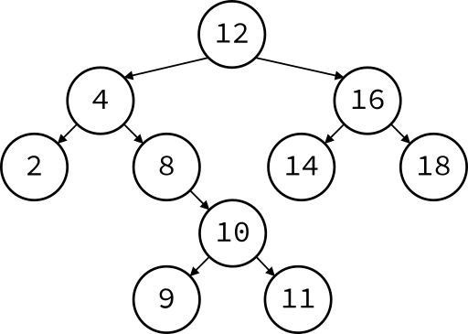
Recursion Examples
Traversing a Binary Search Tree
Sorting data
Image from wikimedia.org
Notes:
https://commons.wikimedia.org/wiki/File:Binary_Search_Tree_-_Remove_Step_3.svg
https://commons.wikimedia.org/wiki/File:Selection-Sort-Animation.gif

Slide 11
Toy Example of Recursion
def compute(intInput):
print(intInput)
if (intInput > 2):
compute(intInput-1)
def main():
compute(50)
main()
This is where the recursion occurs.
You can see that the compute() function calls itself.
What does this program do?
This program prints the numbers from 50 down to 2.

Slide 12
Visualizing Recursion
To understand how recursion works, it helps to visualize what’s going on
Python uses a stack to keep track of function calls
A stack is an important computer science concept
To help visualize, we will

Slide 13
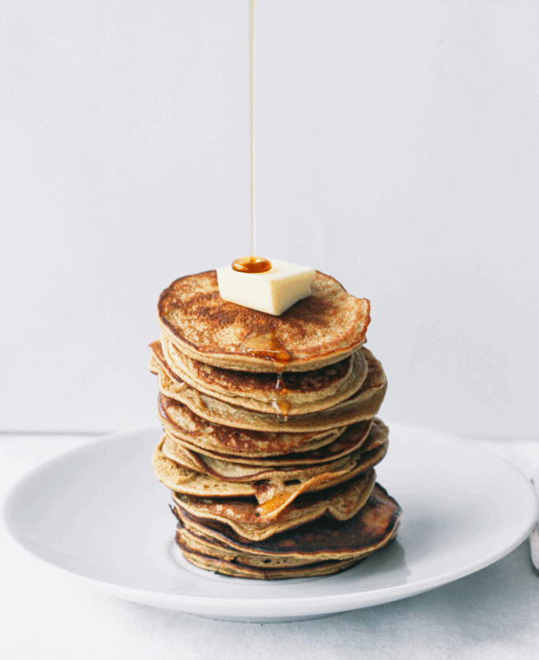
Stacks
Image from www.topwithcinnamon.com
Notes:
http://www.topwithcinnamon.com/2013/01/2-ingredient-healthy-pancakes-gluten-free-dairy-free.html
http://i1.wp.com/www.topwithcinnamon.com/wp-content/uploads/2013/01/OMFGTHISISTHEBESTGIFIVEEVEREVEREVERMADEEE.gif?resize=654%2C800

Slide 14
Stacks
A stack is like a bunch of lunch trays in a cafeteria
It has only two operations:
Push
You can push something onto the top of the stack
Pop
You can pop something off the top of the stack
Let’s see an example stack in action

Slide 15
Stack Example
The diagram below shows a stack over time
We perform two pushes and two pops
8
2
2
2
Time: 0
Empty Stack
Time 1:
Push “2”
Time 2:
Push “8”
Time 3:
Pop
Time 4:
Pop

Slide 16
Stack Details
In computer science, a stack is a last in, first out (LIFO) data structure
It can store any type of data, but has only two operations: push and pop
Push adds to the top of the stack, hiding anything else on the stack
Pop removes the top element from the stack

Slide 17
Stack Details
The nature of the pop and push operations also means that stack elements have a natural order
Elements are removed from the stack in the reverse order to the order of their addition
The lower elements are those that have been in the stack the longest

Slide 18
Stacks and Functions
When you run your program, the computer creates a stack for you
Each time you call a function, the function is pushed onto the top of the stack
When the function returns or exits, the function is popped off the stack

Slide 19
Stacks and Functions Example
square()
main()
main()
main()
Time: 0
Empty Stack
Time 1:
Push: main()
Time 2:
Push: square()
Time 3:
Pop: square()
returns a value.
method exits.
Time 4:
Pop: main()
returns a value.
method exits.

Slide 20
Stacks and Recursion
If a function calls itself recursively, you push another call to the function onto the stack
We now have a simple way to visualize how recursion really works

Slide 21
Toy Example of Recursion
def compute(intInput):
print(intInput)
if (intInput > 2):
compute(intInput-1)
def main():
compute(50)
main()
Here’s the code again.
Now, that we understand stacks, we can visualize the recursion.

Slide 22
Stack and Recursion in Action
compute(2)
compute (3)
compute(3)
compute(3)
compute (4)
compute (4)
compute(4)
compute(4)
main()
main()
main()
main()
main()
…
Time: 0
Empty Stack
Time 1:
Push: main()
Time 2:
Push: compute(4)
Time 3:
Push: compute(3)
Time 4:
Push: compute(2)
Time 4:
Pop
After every function returns (pops)

Slide 23
Defining Recursion

Slide 24
“Cases” in Recursion
A recursive function must have two things:
At least one base case
When a result is returned (or the function ends)
“When to stop”
At least one recursive case
When the function is called again with new inputs
“When to go (again)”

Slide 25
Terminology
def fxn(n):
if n == 1:
return 1
else:
return fxn(n - 1)
Notice that the recursive call is passing in simpler input, approaching the base case
base case
recursive case
recursive call

Slide 26
Recursion Example
def sum(n):
if n == 1:
return 1
else:
return n + sum (n - 1)
What is sum (1) ?
What is sum (2) ?
What is sum (100) ?
We at least know that it’s 100 + sum(99)

Slide 27
Recursion Example
def sum(n):
if n == 1:
return 1
else:
return n + sum (n - 1)
sum(3)
3 + sum(2)
2 + sum(1)
1
3 + 2 + 1 = 6

Slide 28
Factorials
4! = 4 × 3 × 2 × 1 = 24
Does anyone know the value of 9! ?
362,880
Does anyone know the value of 10! ?
How did you know?

Slide 29
Factorial
9! = 9×8×7×6×5×4×3×2×1
10! = 10 × 9×8×7×6×5×4×3×2×1
10! = 10 × 9!
n! = n × (n - 1)!
That's a recursive definition!
The answer to a problem can be defined as a smaller piece of the original problem

Slide 30
Factorial
def fact(n):
return n * fact(n - 1)
fact(3)
3 * fact(2)
3 * 2 * fact(1)
3 * 2 * 1 * fact(0)
3 * 2 * 1 * 0 * fact(-1)
...
What happened? What went wrong?

Slide 31
Factorial (Fixed)
def fact(n):
if n == 0:
return 1
else:
return n * fact(n - 1)
fact(3)
3 * fact(2)
3 * 2 * fact(1)
3 * 2 * 1 * fact(0)
3 * 2 * 1 * 1

Slide 32
Recursion Practice

Slide 33
Thinking Recursively
Anything we can do with a while loop can also be accomplished through recursion
Let’s get some practice by transforming basic loops into a recursive function
To keep in mind:
What is the base case? The recursive case?
Are we returning values, and if so, how?

Slide 34
Non-Recursive getGrade()
Gets a grade between 0 and 100, inclusive
def getGrade():
grade = int(input("Grade? "))
while grade < 0 or grade > 100:
print("That's not valid.")
grade = int(input("Grade? "))
return grade
Transform this into a recursive function

Slide 35
Non-Recursive sumList()
Sum the contents of a list together
def sumList(numList):
total = 0
for num in numList:
total = total + num
return total
Transform this into a recursive function

Slide 36
Recursive Thinking
Sometimes, creating a recursive function requires us to think about the problem differently
What kind of base case do we need for summing a list together? How do we know we’re “done”?
Instead of approaching the problem as before, think of it instead as adding the first element to the sum of the rest of the list

Slide 37
Recursive Summing
myList = [3, 5, 8, 7, 2, 6, 1]
3 + [5, 8, 7, 2, 6, 1]
5 + [8, 7, 2, 6, 1]
8 + [7, 2, 6, 1]
etc...
What is the base case here?
How does the recursive case work?

Slide 38
Announcements
Project 2 out on Blackboard
Project due Friday, April 21st @ 8:59:59 PM
Uses 3D lists and file I/O
Final exam is when?
Friday, May 19th from 6 to 8 PM
Survey #2 out now, due Sunday @ 11:59 PM

